Slide 1

Neuromorphic Robotics for Drones
Roy Ben Hayun
LinkedIn: http://il.linkedin.com/in/roybenhayun
Email: roy.ben.hayun@climate-eyes.earth

Slide 2
Agenda
Introduction
Articles
Neuromorphic PID controller – 1DoF study
Optic-Flow based landing
Event-driven vision and motor-control
Dynamic topology network
Practical work

Slide 3
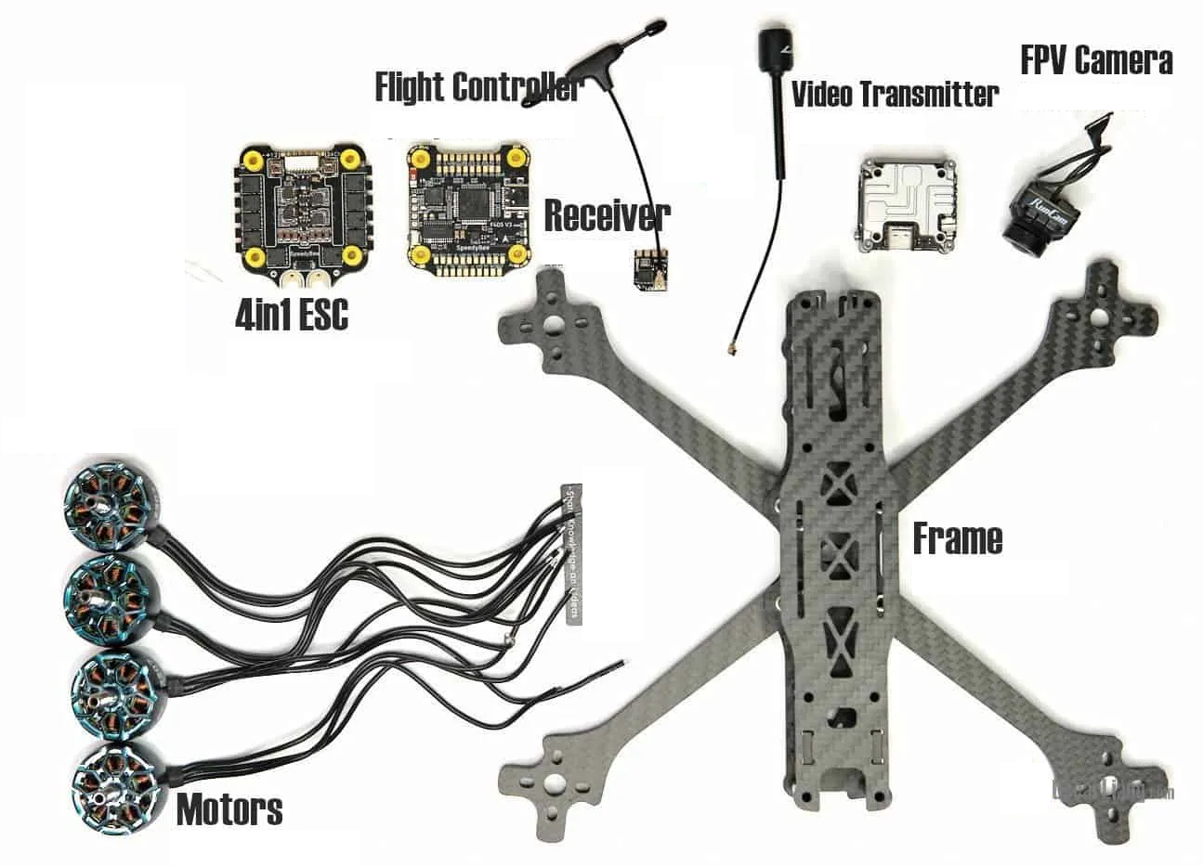
Drones in a nutshell
Notes:
How it’s built
Reference drone

Slide 4
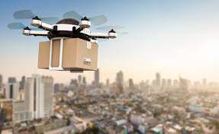
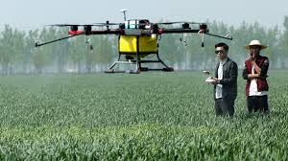
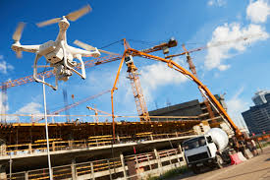
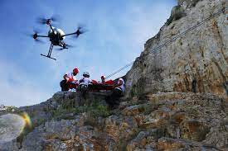
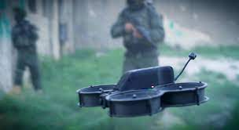

Usages and challenges
Notes:
Usages:
Agriculture, construction, HLS, defense, delivery, search and rescue

Slide 5
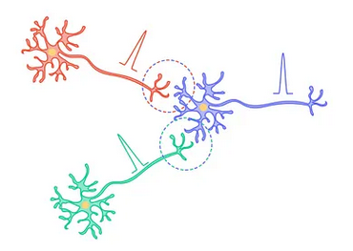
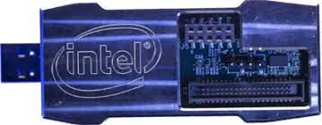
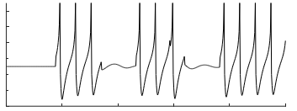
Neuromorphic computing in a nutshell
Neuromorphic Algorithms
Neuromorphic Hardware
Notes:
SNN
brain-inspired software models used in neuromorphic computing
asynchronous and event-based nature
HW:
Not Von Neuman. neuronal models realized in hardware, computed in real time, with co-location of memory and computing units.
Low power due to event-based asynchronous architecture
1+1
Lead to low power, low latency architectures.
orders of magnitude gains in power and performance.
additional key benefit of on-chip plasticity enabling continuous learning in real-time
GENERAL
using large artificial neural networks comes with the need of a large amount of processing power spike neural networks on the other hand
are a type of artificial nerves much closer to the biological nerns they accumulate input current and set out as spike whenever their internal variable the membrane potential reaches the threshold
specialized hardware has been developed to simulate such spike nearings with the goal of low latency and low power usage
while being able to scale to millions of neurons
many of you will already know about artificial neural networks the neurons model based on a very simplified version of the neurons in the biological brain. the artificial neuron summarizes the weighted inputs and outputs a value calculated by a time independent transfer function of the summarized inputs
artificial neurons have no mean of time and therefore no memory
spike neurons heavily rely on memory enzyme a spike neuron integrates the input current over time until a vulture threshold is reached at this time the neuron will send a spike through the connections called synapses to a postsynaptic nerve
the voltage potential of each neuron is calculated at each time step which uses a lot of power when

Slide 6
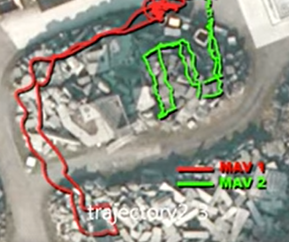
Why neuromorphic computing for drone?
Energy constraints
Latency
Stochastic environments
Power \ Precision
Latency
Edge AI \ Learning
Notes:
Robotics challenges
Motor control, perception, planning, decision making
constraints on latency, energy, and payload
Fit of NBE
precision and energy.
very importantly - learn as they move.
Similar to how biological neural networks allow perception, planning, control and learning with limited energy and limited local sensing only.
FAQ
Why not ANN
substantial computing power often with GPUs
large amount of prepared data for training
ANNs tend to grow

Slide 7
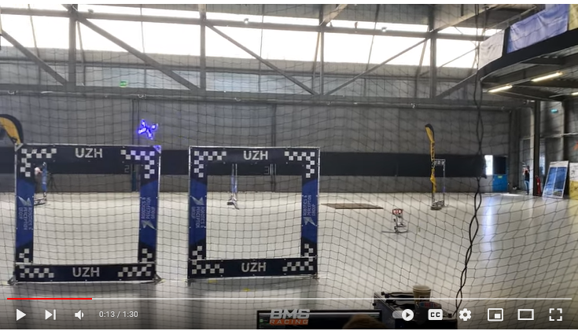
Will autonomous drones replace a skilled human?
https://www.youtube.com/watch?v=PLMgMqMrQ98
Notes:
if you look at the performance of autonomous drones today they are still far from human pilot performance in terms of speed versatility and robustness
The promise of Neuromorphic Computing to drones is therefore to create smart algorithms and learning systems that will expose cognitive capabilities in real time with improved energy consumption and latency, allowing to design robust and efficient autonomous flight systems for autonomous drones.

Slide 8
Agenda
Introduction
Articles
Neuromorphic PID controller – 1DoF study
Optic-Flow based landing
Event-driven vision and motor-control
Dynamic topology network
Practical work

Slide 9

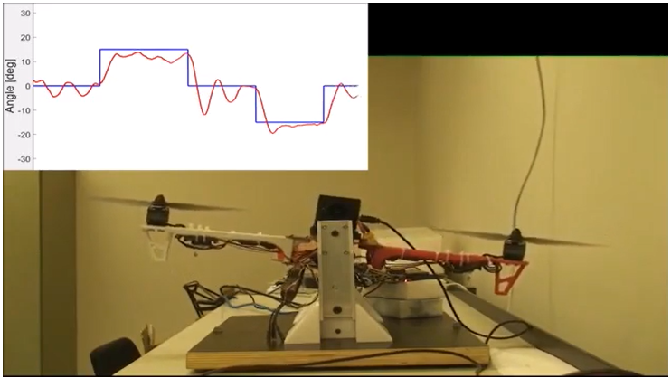
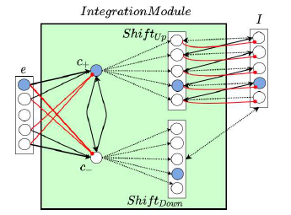
Overview
Improve a 1 DOF neuromorphic PID Controller
Motivation: aim to unified neuronal architecture, start with motor control
Goal: design and performance improvements of the PID Controller
https://youtu.be/lnGQqz7MM8w
Notes:
rotating between -20◦ to +20◦ on the Y axis, according to a given desired angle.
Motivation: aim toward integrated neuronal capabilities, starting from motor control. motor control will be tightly integrated into a unified neuronal architecture.
Goal: improvements before progressing further

Slide 10
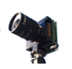
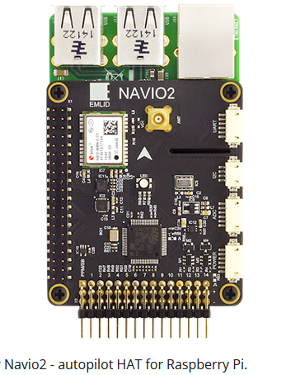
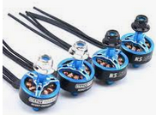
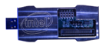
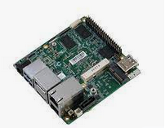
System overview
IMU node
Current setpoint
Motors
ESC node
Current setpoint
Loihi node
Motor command
Current setpoint
Control Setpoint node

Slide 11
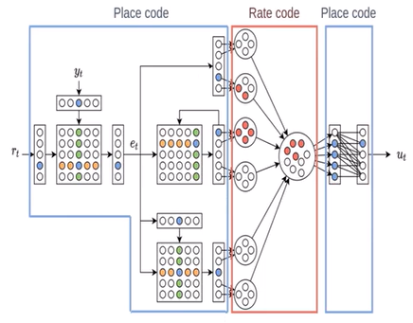
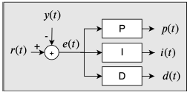
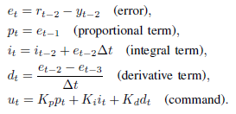
Baseline work: existing neuromorphic PID Controller
i(t)
adding current error with last integrated error
P
EM
IM
I
e(t)
subtracting control from sensory feedback
DM
d(t)
subtracting delayed error from current error signal.
D

Slide 12
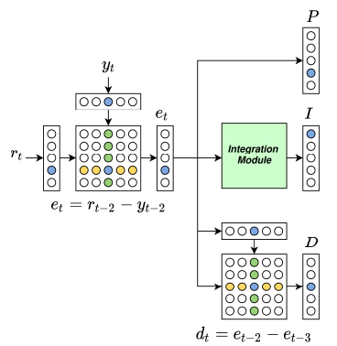
Baseline work: existing neuromorphic PID Controller
index encodes input value One neuron each time
integration module computes the integral of the error
1) The sensor feedback (y) is subtracted from the setpoint (r) to obtain the error value (e)
2) the error on one time step is subtracted from the error on the previous time step to obtain the derivative term.

Slide 13
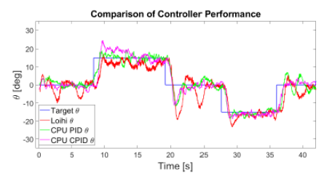
Improvement and redesign of the PID Controller
Issues:
Sensors and host CPU delays
Long time-step duration
Number of time-steps
Two nested PID controllers
Goals:
Redesign I-path
Simplify SNN
Improve IO integration

Slide 14
Improved SNN I-path (high SNN expertise)
5. I-term output population
Place-Coding
2. Black: Excitatory connections
1. Current error population
2. Weights depend on index
4. ShiftDown and ShiftUp
shift active neuron in I population
Excite or inhibit I neurons
2. Red: Inhibitory connections
3. c+ and c− are counter neurons
(High threshold, low leakage)
integrate positive and negative errors
Notes:
Solves oscillation caused due to 63 neurons low-resolution in input neurons
When C fires it excites all neurons in I
Only 1 will be excited also by the I population and therefore activated
SNN expertise in a nutshell
e has weights depending on index, and usage of Excitory and Inhibitory
C have high threshold and low leakage
For Shift neurons to fire, also the respective I neuron must fire same time with C
Shift neurons excite or inhibit I neurons
Place coding vs Rate coding vs Temporal coding
E.g., Place is easier for output command, Rate is better for summation
Shift up \ down, Accumulate

Slide 15
Improvements ready for rigorous testing
Before:
I-term saturation
Two nested controllers
IO delays
20kHz frequency
12 time-steps
27ms time-step duration
54 neuro-cores
After:
Robust I term
Single PID controller
Improved IO
1kHz frequency
6 time-steps
10ms time-step duration
38 neuro-cores

Slide 16
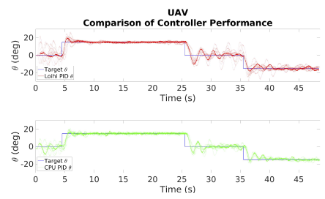
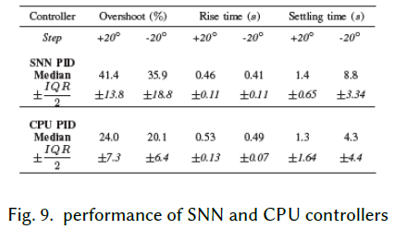
Results, Comparison and Conclusions
Slightly higher overshoot
Slightly faster rise time
Similar settling time
Goal achieved: drastic improvement of the neuromorphic PID Controller

Slide 17
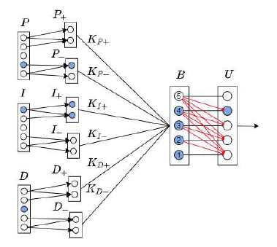
SNN output network
2. Scaled and summed in population B
1. All 3 split to 2 pos\neg populations
Neuron threshold
3. Output population U
Values between
[−lim, lim].
4. Output signal converted to motor command
X86 maps the spikes’ source index to a value in the range [−1, 1]Nm.
Excitory one-to-one connections
Inhibitory connections to all lower indices neurons
Synaptic weights of respective PID gain
Notes:
SNN expertise
In output network, neurons connect to varying number of neurons
Linearly decreasing threshold
Bias current equal to middle neuron injected to all
Transition from Place Coding to Rate Coding

Slide 18
Agenda
Introduction
Articles
Neuromorphic PID controller – 1DoF study
Optic-Flow based landing
Event-driven vision and motor-control
Dynamic topology network
Practical work

Slide 19
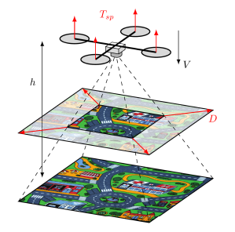
Overview
reality gap between simulation and the real world
Motivation: bridging the reality-gaps (sim to real world, real neuro-chip)
Goal: run SNN on Loihi integrated on real drone
https://youtu.be/LGkjlG-OjaU
Notes:
In previous work:
demonstrate learned neuromorphic control for a real-world problem through evolving SNNs for performing divergence based landings
reduce the spike rate of the SNN controller
In this work:
Motivation: bridging the other reality gaps which were not handled in the neuro-evolution work
Goal: land with the trained SNN, running on Loihi on drone

Slide 20
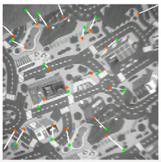
Background: Optic Flow Divergence
NOTE: not using neuro-chip yet
Location of tracked point in previous frame
Location of tracked point in current frame
Notes:
Reminder:

Slide 21
Background: Neuro-evolution algorithm
Evolution starts with [4] randomly initialized population of [100] individuals
Each individuals tested in same [4] varying landings
Fitness of individual is evaluated
by time to land, final height, final vertical velocity, total spike rate
Selection carried out
Weights and parameters are mutated every generation [total 400 generations]
At all time – “hall of fame” is kept
Hall of fame individuals are tested in 250 landings
Best performing individuals go for real-world tests

Slide 22
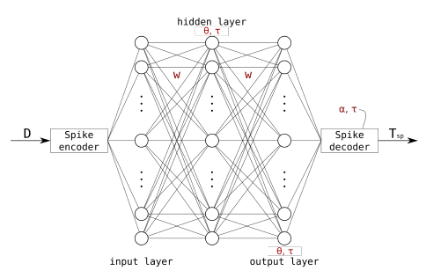
Three layers SNN (20 | 10 | 5)
Red variables are the
evolved parameters.
10 neurons
decoding from spikes
to continuous Tsp
20 neurons
Position-Coding
5 neurons
Notes:
W is the synapse value
Theta is the threshold value
a,t are decoding-related scale-parameters – may cause delays

Slide 23
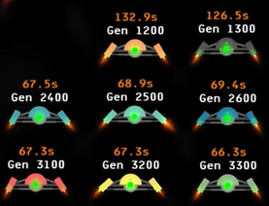
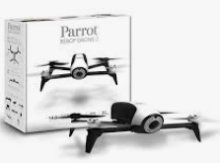
From evolving in simulation to real-world
Measure: oscillations, landing time, touch-down velocity, spike rate etc
Conclusion: bridged simulation to real-world
Best performing individuals
But, not using neuro-chip!
(Using TinySNN – a C implementation – on CortexA)

Slide 24
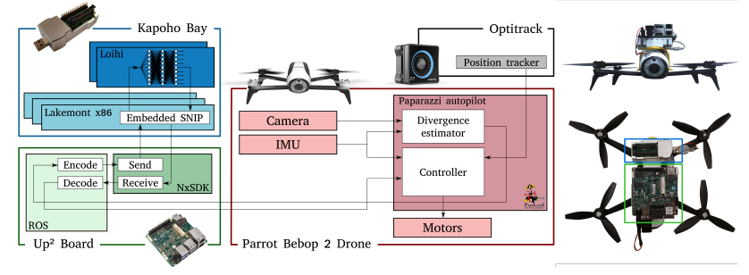
Integration of Loihi with drone and CPU

Slide 25
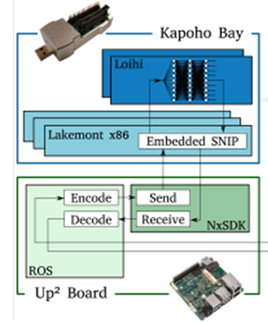
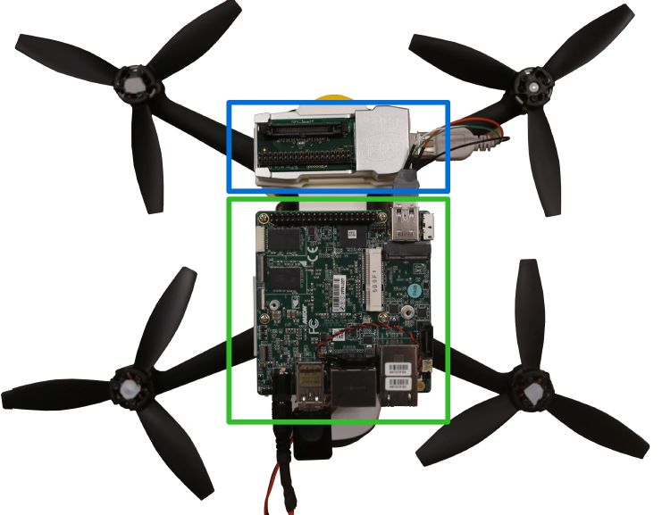
Integration of Loihi with drone and CPU

Slide 26
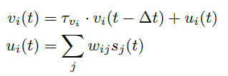
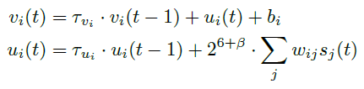
From simulation to neuro-chip: Loihi LIF model
Gaps:
Variances in neuron LIF models
Loihi neurons update cycle
Adjustments:
Mimic Loihi neurons, delay buffers

Slide 27
From simulation to real-world: Loihi on real drone
Intermediate pre-flight testing: comparison with offline Loihi chip
Comparison with Loihi integrated on real drone
(Adjust) and record
Offline Loihi
Loihi on drone
Notes:
Record: input (divergence error), output (thrust setpoint), spikes in hidden layer

Slide 28
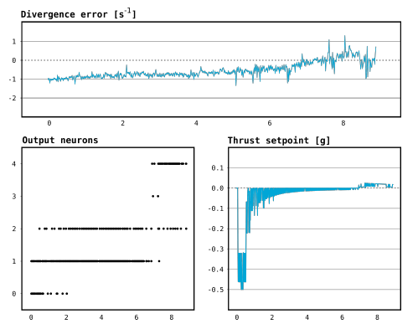
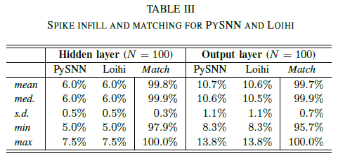
Results
https://youtu.be/LGkjlG-OjaU
Simulation and offline pre-flight
Real-world drone with Loihi
Notes:
Using an evolutionary approach, closed the reality gap between simulated and on-chip SNNs
resulting controller consisting of only 35 neurons.
real-world landing tests from 4m, proved robust and consistent.

Slide 29
Agenda
Introduction
Articles
Neuromorphic PID controller – 1DoF study
Optic-Flow based landing
Event-driven vision and motor-control
Dynamic topology network
Practical work

Slide 30

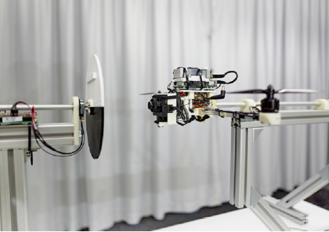
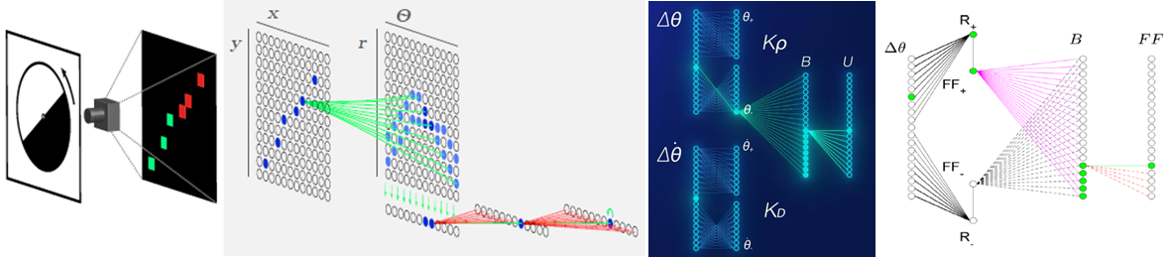
Overview
Integration of event-vision and motor-control for high speed
Motivation: neuromorphic capabilities integrated for high speed
Goal: integrate neuromorphic event-based vision, motor-control, learning
https://youtu.be/EcZ_Nq6Z89U
Notes:
In previous work:
In this work:
Motivation: need faster sensors, faster algorithms, faster processing. Unified neuromorphic architecture has a promise to fulfil.
Goal: integrate neuromorphic event-based vision, motor-control

Slide 31
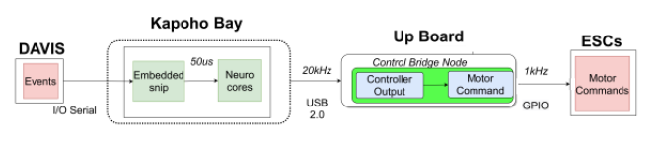
System overview

Slide 32
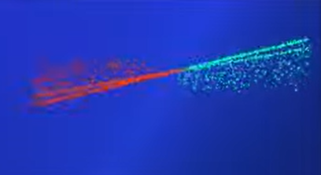
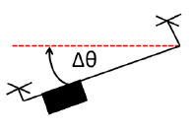

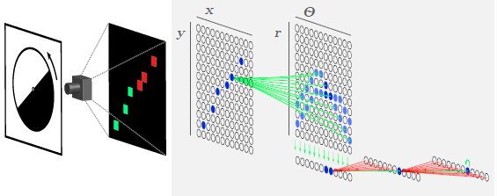
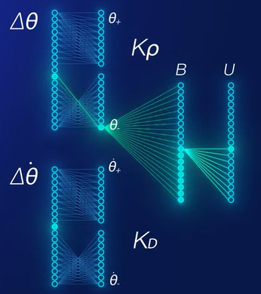
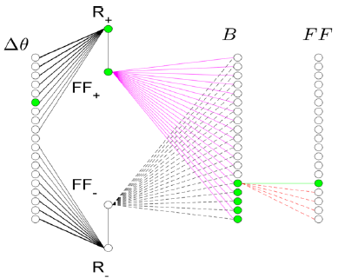
Neuromorphic Sub-Systems Overview
Event based vision
Motor control
On-chip learning
Notes:
visual line-tracking

Slide 33
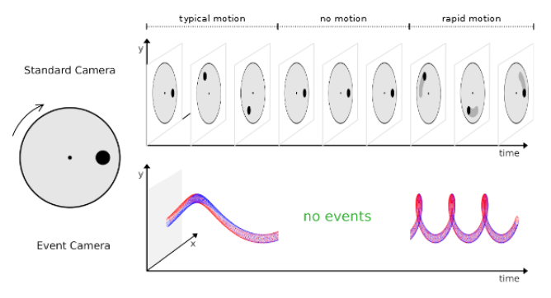
Event-Camera
Notes:
HT
Points laying on the same line in the Cartesian space are mapped to intersecting sine curves in the Hough space (the -r space).
Therefore, for many points on the same line, the (; r) pair with the highest intersection density represents the correct line in Cartesian space.

Slide 34
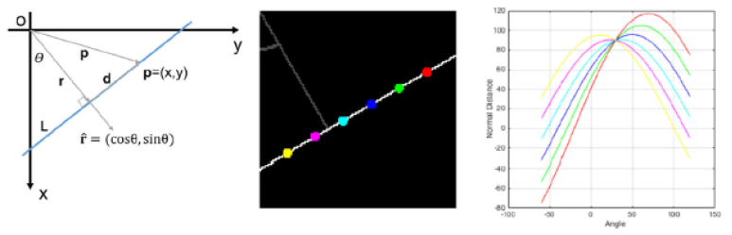
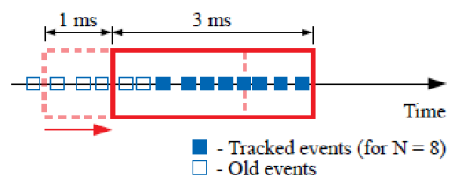
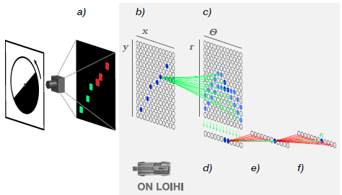
Hough-Transform to event-based
Notes:
HT
Points laying on the same line in the Cartesian space are mapped to intersecting sine curves in the Hough space (the -r space).
Therefore, for many points on the same line, the (; r) pair with the highest intersection density represents the correct line in Cartesian space.

Slide 35
Event Based Vision SNN
B: represent events in
Cartesian Space
A: Event-stream down-sampled
C: represent events in
Hough Space
D: connecting all neurons that correspond
to the same to a respective readout (“angle”) neuron
F: “memory” storing activity from
the previous time step.
for stationary scenarios
E: cleaning up activity

Slide 36
Motor Control - PD Controller

Slide 37


On-chip learning
4. when R neurons fire, synaptic weight changes according to learning rule
2. R neurons accumulate errors.
Fire only if reached threshold
err(t)
1. Place-Coding representation of err(t)
6. Feedforward term
Weights are proportional to error magnitude
3. F neurons responsible for increasing and decreasing the feedforward term
5. B uses Multi-Shot Position-Coding by ordered thresholds
Weights are negative or positive according to f
Notes:
adaptive term in the controller that modifies the controller output in case the PD controller fails to remove the error (e.g., due to added load).
compensate for extended periods of large steady-state errors.
additive feed-forward layer that connects the input population to the output u
learning rule on Loihi can be composed by a combination of pre- and post-synaptic spikes, auxiliary variables representing recent activity, and a third factor, called the reinforcement channel.

Slide 38


Comparison with CPU
Low-speed tracking
High-speed tracking - RMSE
Notes:
High-speed: visual processing running 20-times faster on Loihi
Low-speed: network’s parameters tuned for high speed. So worse performance of the SNN.

Slide 39


On-chip learning
Notes:
additional weight of 125g attached to one side of the drone’s arm.

Slide 40
Results
Integrated fast event-based vision and event-based control
Achieve very low latency fast processing at extremely low power
Explored on-chip learning with external disturbances
Pave the way to more neuromorphic applications
Notes:
Other optimizations:
Efficient neuron allocation
More neurons in 1D allowing finer\wider values
AER integration
DMA instead of UART

Slide 41
Agenda
Introduction
Articles
Neuromorphic PID controller – 1DoF study
Optic-Flow based landing
Event-driven vision and motor-control
Dynamic topology network
Practical work

Slide 42


Deep Neuromorphic Controller with Dynamic Topology
Neuronal networks that change their topology at runtime
Motivation: Need for multiple tasks at dynamic environments with disturbances, without pre-training
Goal: formulate flexible and stable learning approach for changing network topology
Disclaimer: article is “work in progress” stage
Notes:
In previous work:
In this work:
Motivation: Goal:

Slide 43

Dynamically changing topology example
Increase of decrease the network capacity based on criteria (Bias, Variance) and inspired from several models
Notes:
High Variance == Over Fitting => prune nodes
High Bias == Underfitting => Add nodes

Slide 44

Reference signal
e(k)
u(t)
e(k-1)
e(k-2)
1. created with a single hidden layer and single node.

Slide 45

2. high-bias condition is identified, new node inserted

Slide 46

3. significant change in dynamics identified, layer expansion
Notes:
Concept Drift Detection Method (mean gradient, confidence level) indicates on need
Copy last layer
New weights between prev and new (will be adjusted)
New weights copied

Slide 47

4. high-bias condition is identified, new node inserted

Slide 48

4. high-variance identified, node pruned

Slide 49





A. High Bias condition
B. High Variance condition
C. Node contribution
A. Gradient mean bias
B. Saturated performance

Slide 50

Compare fixed and dynamic capacity models
In Simulation, track a circle trajectory with slow and fast speed

Slide 51



Slide 52

Compare fixed and dynamic capacity models

Slide 53
Compare fixed and dynamic capacity models

Slide 54

Compare fixed and dynamic capacity models

Slide 55

Compare fixed and dynamic capacity models

Slide 56
Agenda
Introduction
Articles
Neuromorphic PID controller – 1DoF study
Optic-Flow based landing
Event-driven vision and motor-control
Dynamic topology network
Practical work

Slide 57

Practical work
PID controller with Nengo and AirSim
Motivation: neuromorphic capabilities integrated to unified architecture
Goal: start from the most basic building block
Notes:
In previous work:
In this work:
Motivation: need faster sensors, faster algorithms, faster processing. Unified neuromorphic architecture has a promise to fulfil.
Goal: integrate neuromorphic event-based vision, motor-control

Slide 58


Simulation environment

Slide 59

Neuromorphic PID Controller

Slide 60
Neuromorphic PID Controller

Slide 61



Tuning the SNN
Number of Neurons
Radius
Integrator tau
Synapse

Slide 62




CPU vs SNN – overall comparable

Slide 63




1. Same configuration, different number of neurons

Slide 64




2. Same PIG Gains, different radius, synapses

Slide 65

3. Integrator radius
Integrator radius=1
Integrator radius=3

Slide 66
Observations
More parameters controlling e.g., gains, radius, synapses, neurons => impact on PID tuning with more parameters
Radius works as Clamping
Builtin Integrator slow response
Harder to debug
More complex then a CPU-PID which is pretty much straightforward (again, not expecting a win in this simplistic example)
Inaccuracy of outputs is reflected e.g., after settling

Slide 67
Observations
Variability of behavior in SNN-PID resulting from the non-deterministic and imperfect accuracy of neurons output
Wider spectrum of variability due to the additional tunable parameters beyond PID Gains e.g., number of neurons, radius, synapses etc
Different behavior dynamics between deterministic rigid dynamic in imperative CPU-PID and softer with variability dynamics in neuromorphic SNN-PID

Slide 68




Demo

Slide 69
Neuromorphic Robotics for Drones
Roy Ben Hayun
LinkedIn: http://il.linkedin.com/in/roybenhayun
Email: roy.ben.hayun@climate-eyes.earth

